Slide 1
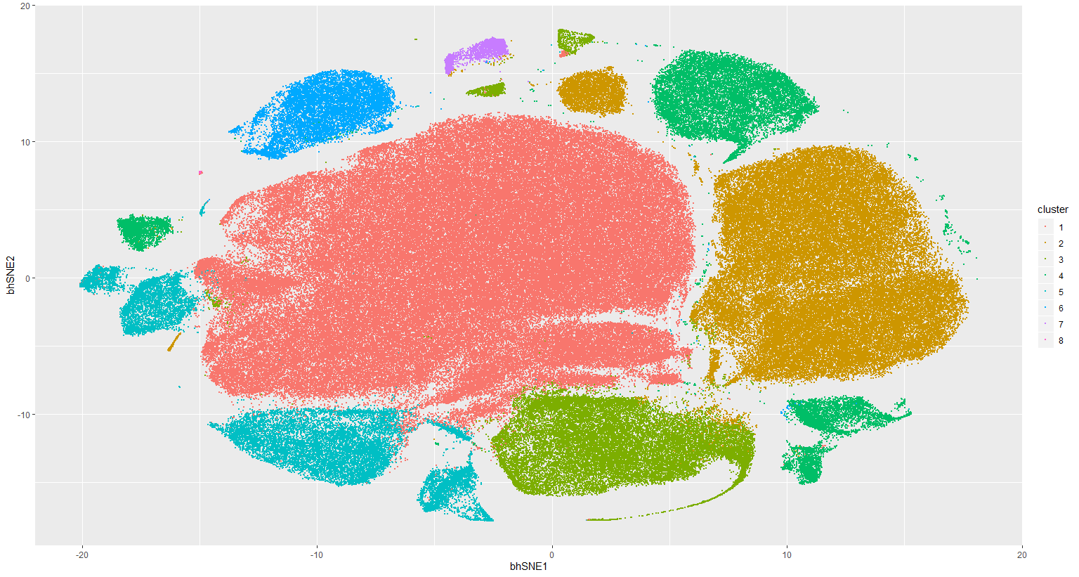
Notes:
ccRCC_652T_Tcells 8
<number>

Slide 2
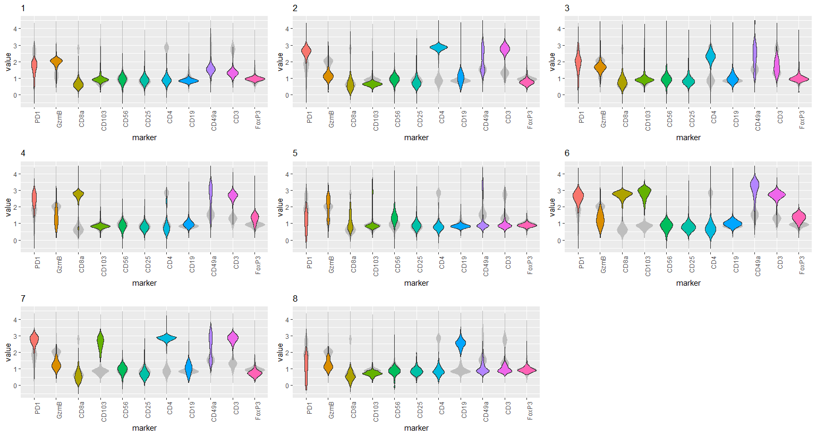
Notes:
ccRCC_652T_Tcells 8
<number>

Slide 3
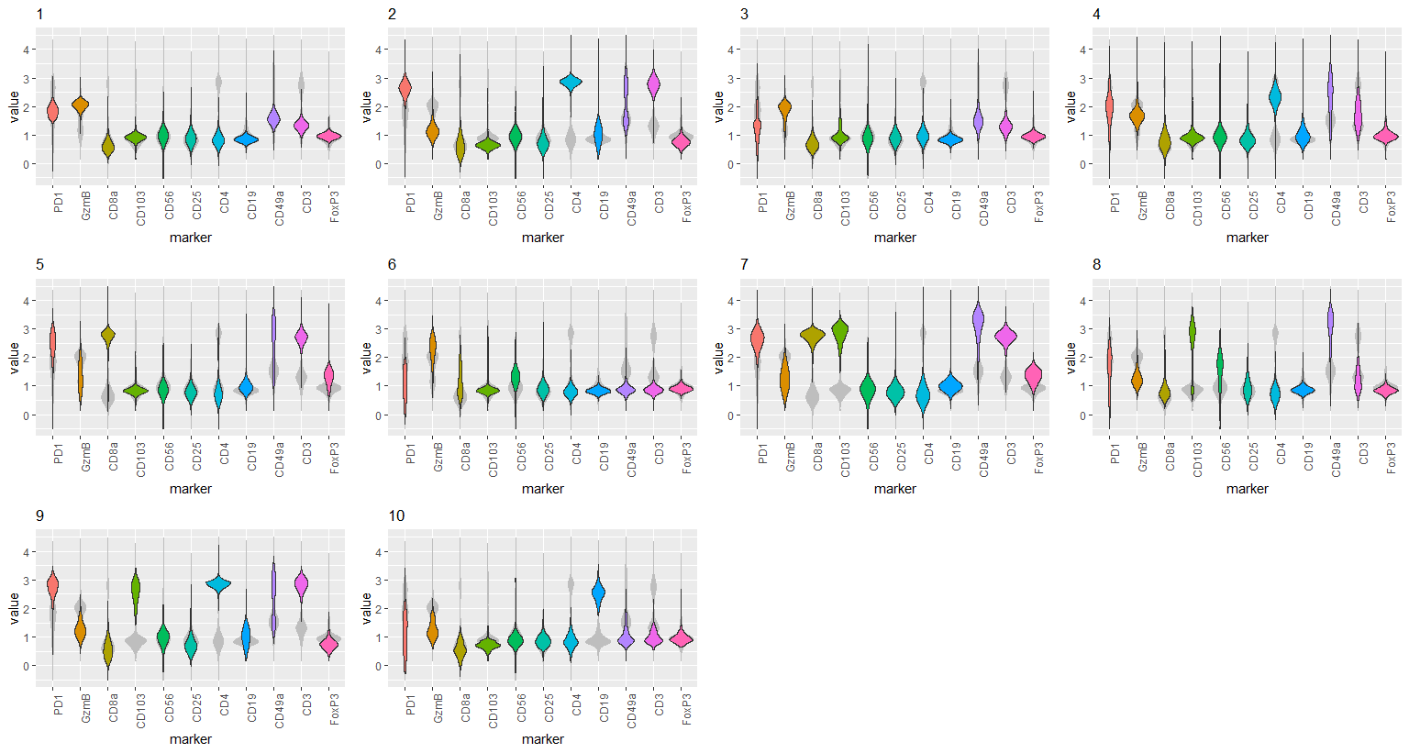
Notes:
ccRCC_652T_Tcells 10
<number>

Slide 4
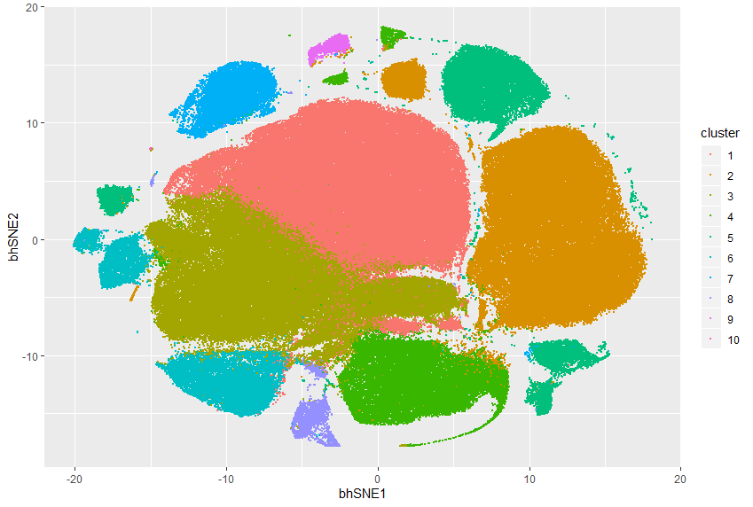
Notes:
ccRCC_652T_Tcells 10
<number>

Slide 5
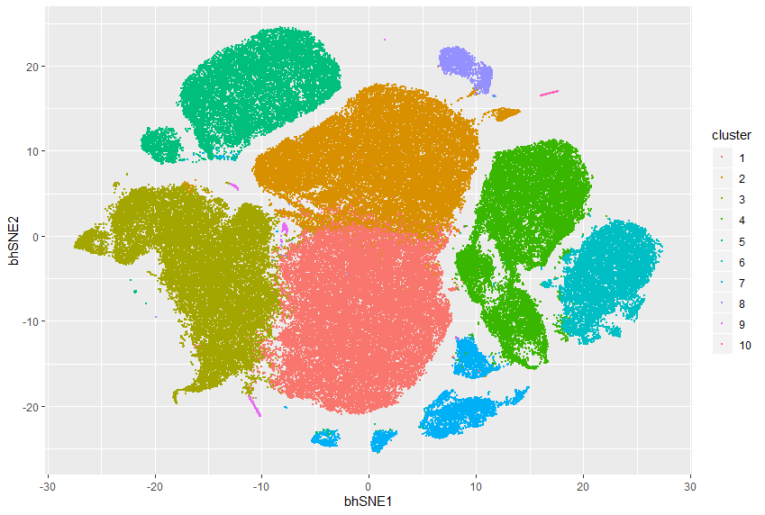
Notes:
ccRCC_652T_Tcells 10 removal of insensitive cluster
<number>

Slide 6
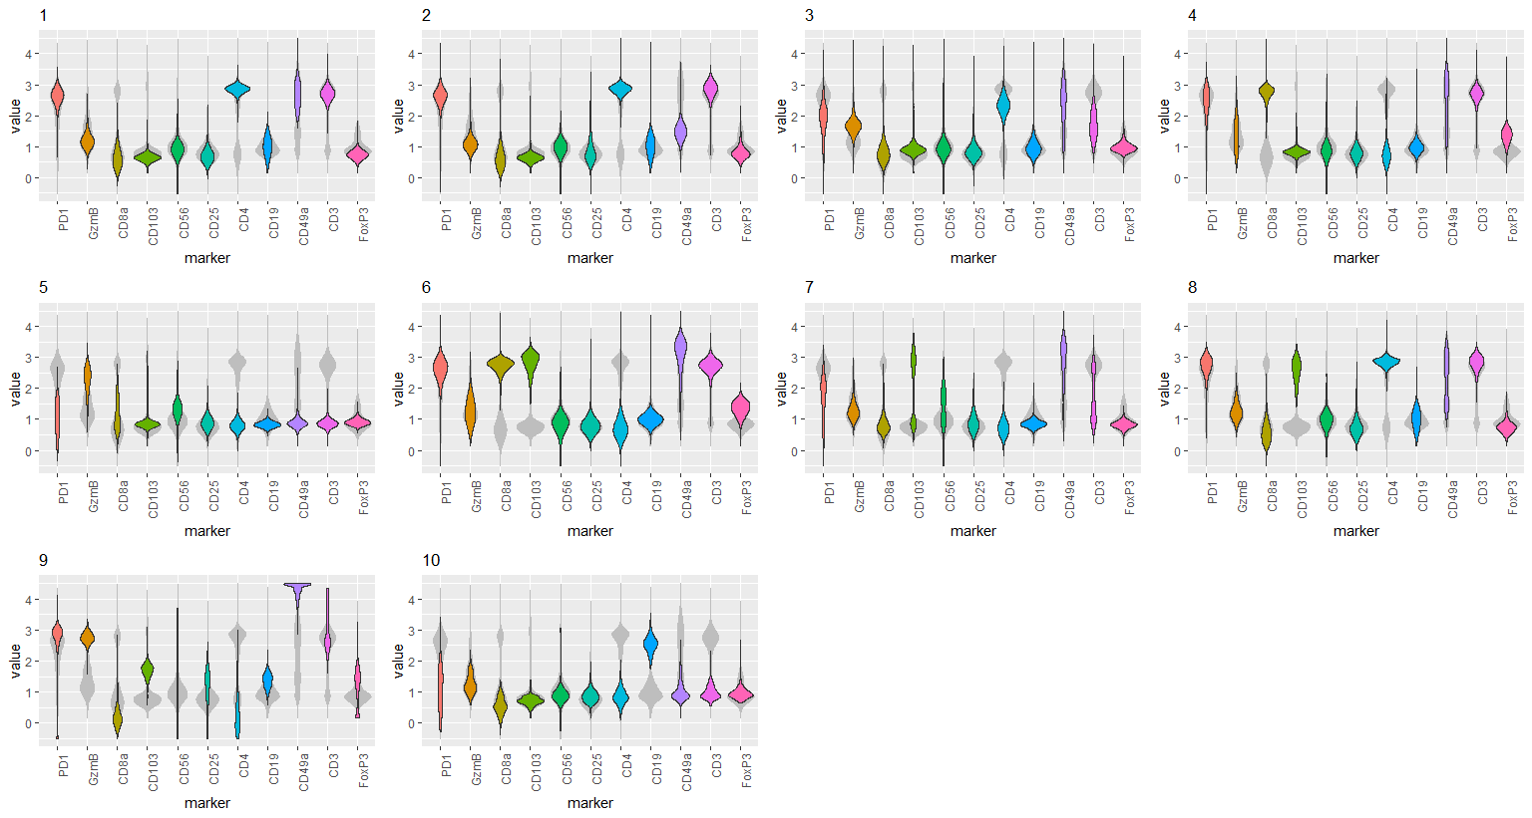
Notes:
ccRCC_652T_Tcells 10 removal of insensitive cluster
<number>

Slide 7
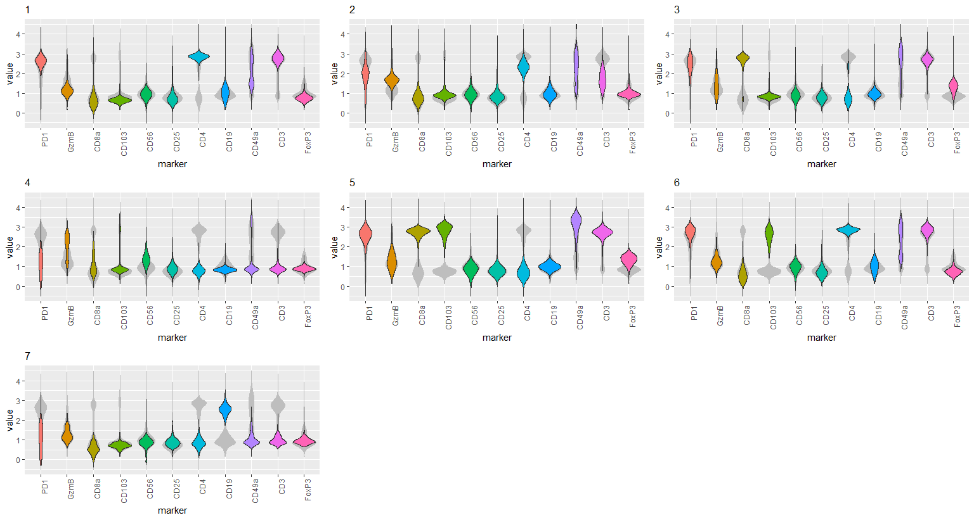
Notes:
ccRCC_652T_Tcells 7 removal of insensitive cluster
<number>

Slide 8
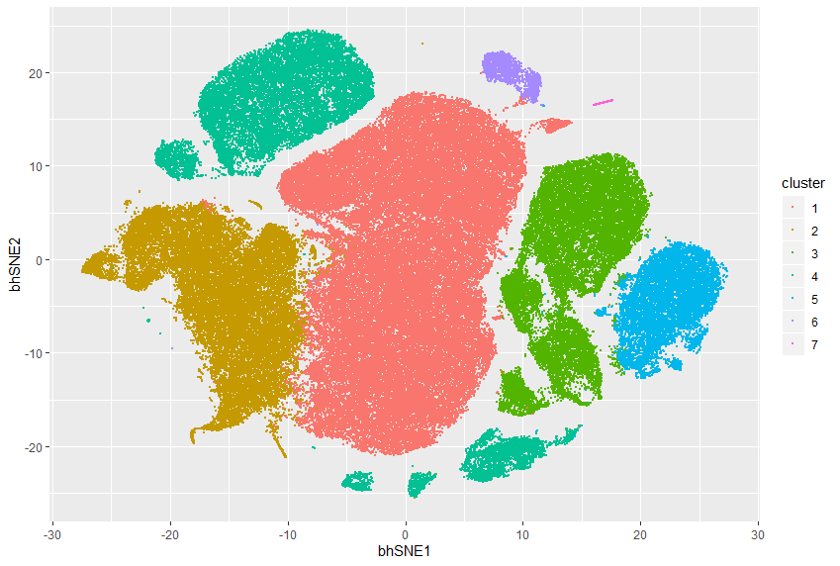
Notes:
ccRCC_652T_Tcells 7 removal of insensitive cluster
<number>

Slide 9
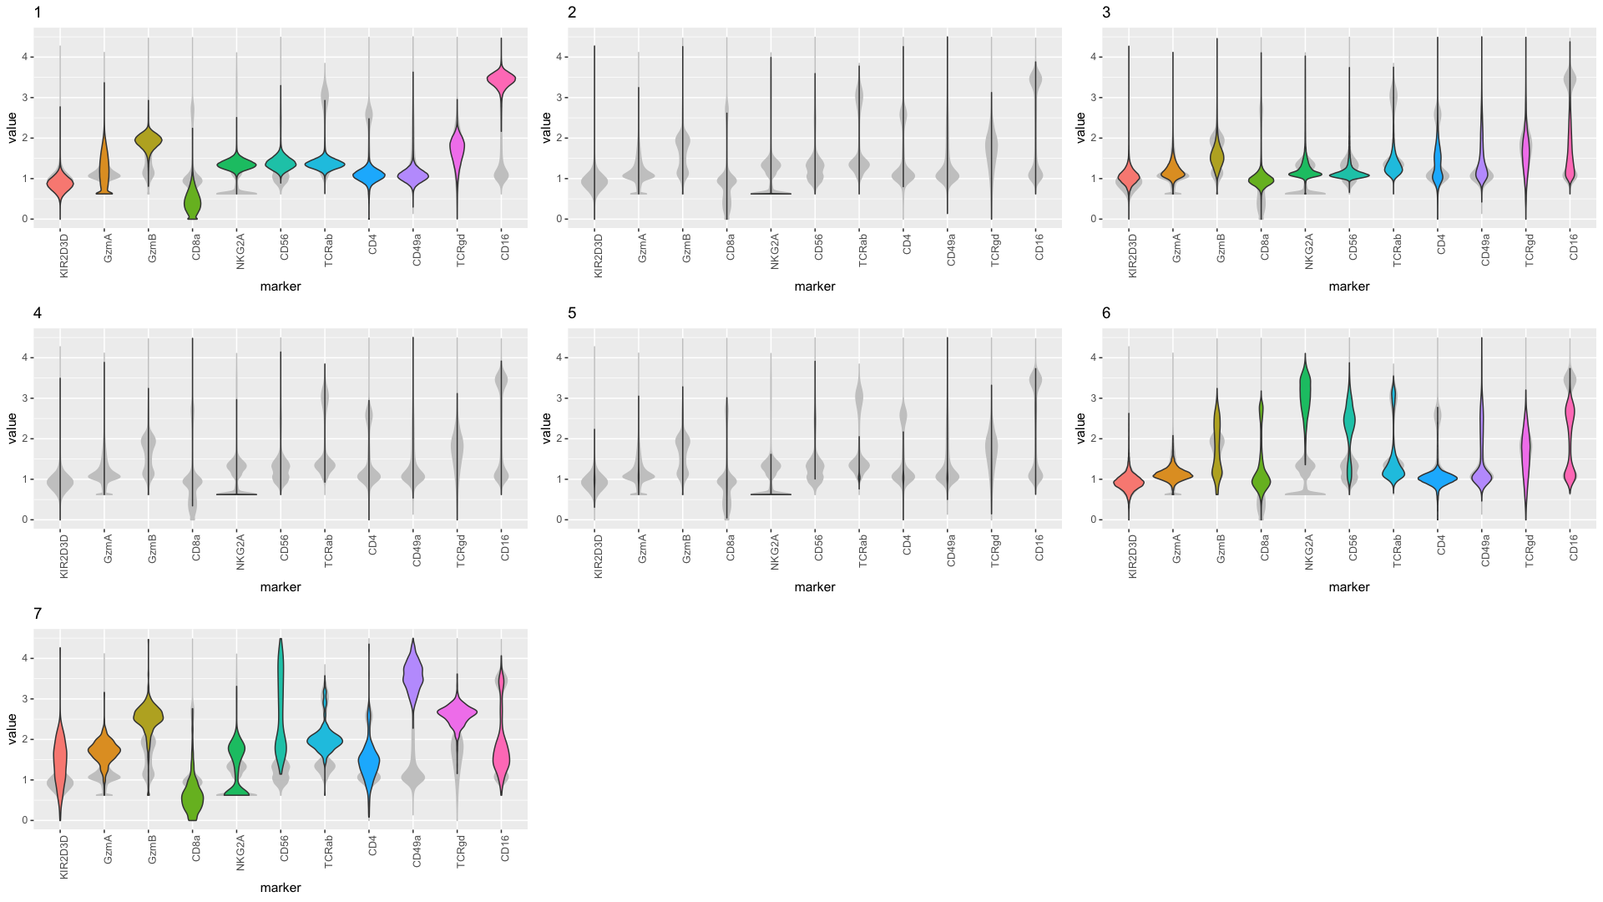

Slide 10
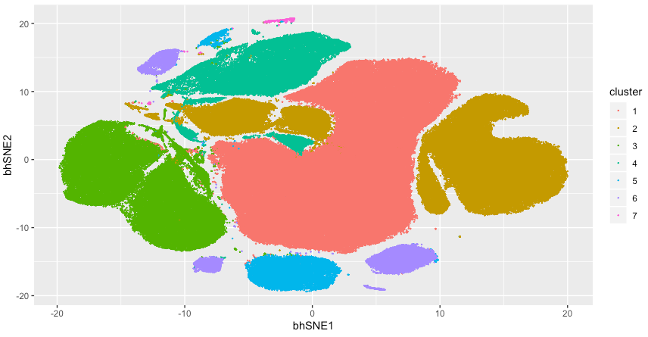

Slide 11
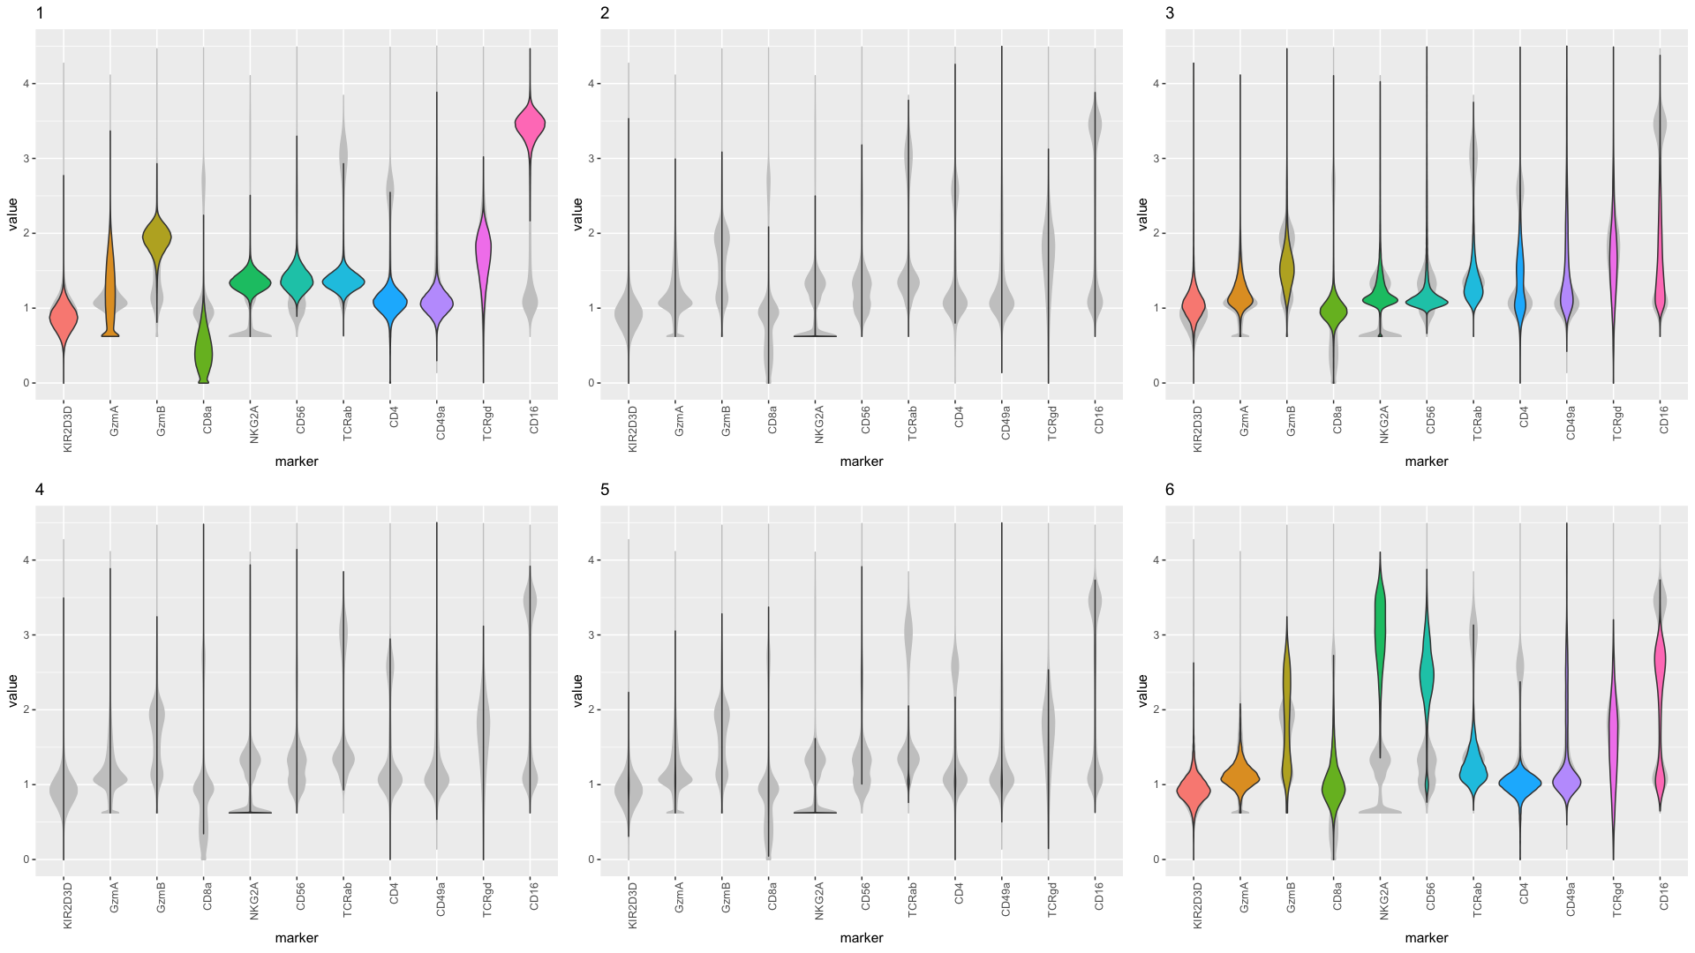

Slide 12
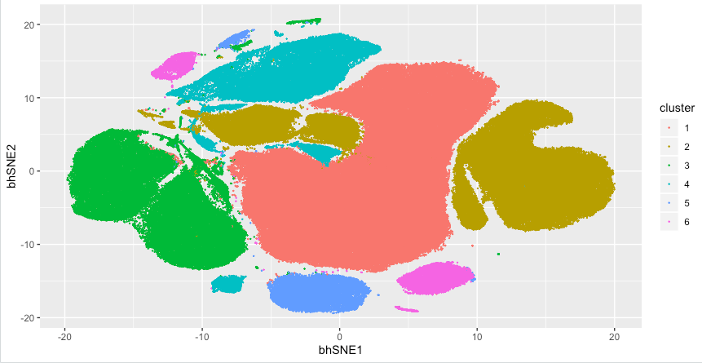

Slide 13
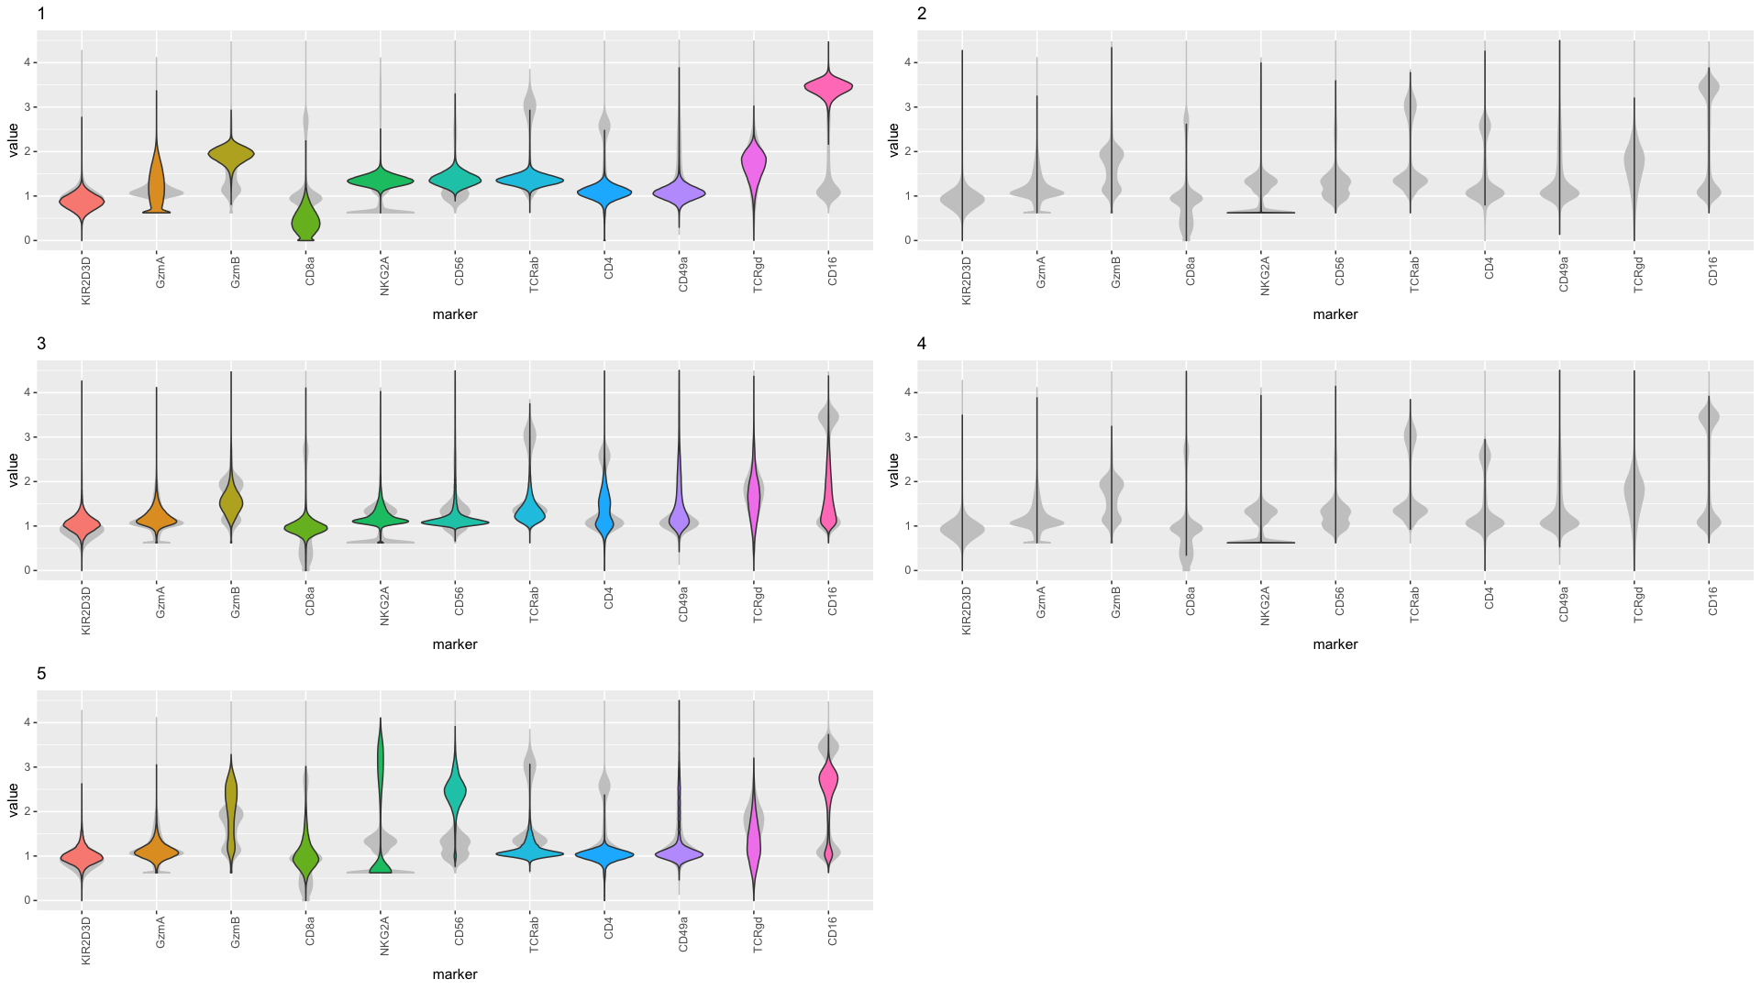

Slide 14
